Slide 1
Cloud Computing

Slide 2
Introduction
Cloud Computing provides us a means by which we can access the applications as utilities, over the internet. It allows us to create, configure, and customize applications online
With Cloud computing users can access database resources via the internet from anywhere for as long as they need with out worrying about any maintenance or management of actual resources.
What is Cloud?
The Term Cloud refers to a Network and Internet . In other words we can
Say that Cloud is something Which is present at remote location Cloud can provide services over network, i.e., on public networks or on Private networks i.e., WAN,LAN or VPN
Applications such as e-mail,web Conferencing , Customer relation management (CRM) all run in cloud

Slide 3
What is Cloud Computing
Cloud Computing refers to manipulating and accessing the applications online , It offers online data storage, infrastructure and application
Cloud Computing is both a combination of software and hardware based computing resources delivered as a network service
Definition
Cloud Computing is an emerging Computing Technology that uses the internet and central remote servers to maintain data and application

Slide 4
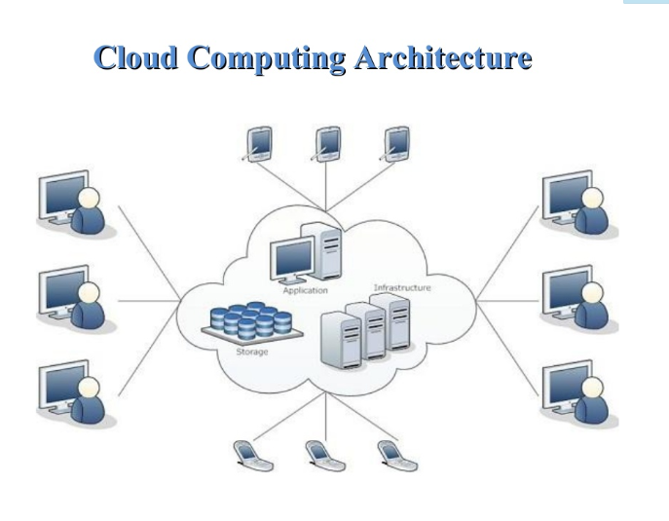

Slide 5
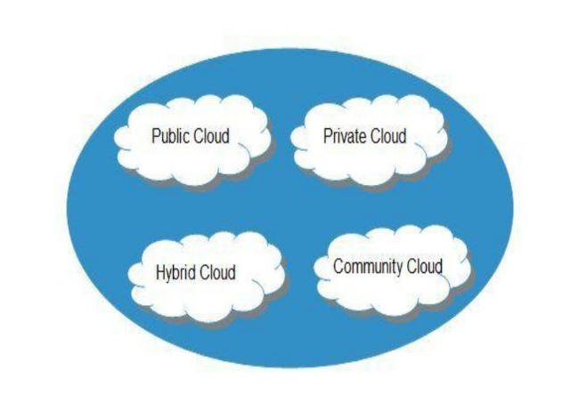
Basic Concepts
1.Deployment Models
2.Service Models
Deployment Models

Slide 6
Public cloud As the name suggests, this type of cloud deployment model supports all users who want to make use of a computing resource, such as hardware (OS, CPU, memory, storage) or software (application server, database) on a subscription basis. Most common uses of public clouds are for application development and testing, non-mission-critical tasks such as file-sharing, and e-mail service.
Private cloud True to its name, a private cloud is typically infrastructure used by a single organization. Such infrastructure may be managed by the organization itself to support various user groups, or it could be managed by a service provider that takes care of it either on-site or off-site. Private clouds are more expensive than public clouds due to the capital expenditure involved in acquiring and maintaining them. However, private clouds are better able to address the security and privacy concerns of organizations today.
Hybrid cloud In a hybrid cloud, an organization makes use of interconnected private and public cloud infrastructure. Many organizations make use of this model when they need to scale up their IT infrastructure rapidly, such as when leveraging public clouds to supplement the capacity available within a private cloud. For example, if an online retailer needs more computing resources to run its Web applications during the holiday season it may attain those resources via public clouds.
Community cloud This deployment model supports multiple organizations sharing computing resources that are part of a community; examples include universities cooperating in certain areas of research, or police departments within a county or state sharing computing resources. Access to a community cloud environment is typically restricted to the members of the community.

Slide 7
Service Models
Service Models are the references models on which the Cloud Computing is based.
These can be categorized into three models as listed below
1.Infrastructure as a Service(IaaS)
2.Platform as a Service(PaaS)
3.Software as a Service(SaaS)

Slide 8
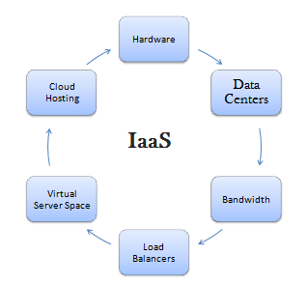
Infrastructure as a Service(IaaS)
Infrastructure as a service (IaaS) is a form of cloud computing that provides virtualized
computing resources over the internet. IaaS is one of the three main categories of
cloud computing services
IaaS architecture and how it works
Infrastructure as a service (IaaS) is a form of cloud computing that provides virtualized
computing resources over the internet. IaaS is one of the three main categories of
cloud computing services,

